Slide 1


Project: Predictive Modelling for Attorney Involvement in Claims.(P519)
1.Varanasi Karthik
2. Sibasankar Rauta
3.Laxmi Awati
4.Chennampalli Lokesh
5.Anurag Gundapi
6.Margi Mishra

Slide 2
CONTENT
Introduction
Overview of Dataset
EDA
Data Visualization
Data Preprocessing
Model Building
Model Selection
Accuracy’s
Selecting a Suitable Model
Deployment
Conclusion

Slide 3
Introduction
Business Objective:
The goal of this project is to develop a model that predicts whether an attorney will be involved in a claim based on various claim-related factors. This will help insurance companies optimize their processes, reduce legal costs, and better allocate resources.
Data:
The dataset comprises 1,340 records with 13 variables that will be analyzed to identify key patterns, temporal trends, and external influencing factors for developing a robust predictive model to forecast attorney involvement in insurance claims, enabling proactive claim management and optimized resource allocation.
Goal:
The primary goal of the Predictive Modeling for Attorney Involvement in Claims project is to develop an analytical system that accurately forecasts which insurance claims are likely to involve attorney representation, enabling early identification of high-risk claims, implementation of proactive management strategies, and optimization of financial reserves and resources.

Slide 4
DATASET DETAILS:
The dataset contains 1,340 rows and 13 columns:
1. CASENUM - Numerical (Integer): Unique case identifier.
2. ATTORNEY - Binary (0 or 1): Indicates if an attorney was involved (1 = Yes, 0 = No).
3. CLMSEX - Categorical (0 or 1): Gender of the claimant (1 = Male, 0 = Female).
4. CLMINSUR - Binary (0 or 1): Whether the claimant was insured (1 = Yes, 0 = No).
5. SEATBELT - Binary (0 or 1): Seatbelt usage (1 = Yes, 0 = No).
6. CLMAGE - Numerical (Integer): Age of the claimant.
7. LOSS - Numerical (Float): Financial loss associated with the claim.
8. Accident Severity - Categorical (Minor, Moderate, Severe): Level of severity.
9. Claim_Amount_Requested - Numerical (Float): Initial claim amount requested.
10. Claim_Approval_Status - Binary (0 or 1): Whether the claim was approved (1 = Yes, 0 = No).
11. Settlement Amount - Numerical (Float): Final settlement amount paid.
12. Policy Type - Categorical (Comprehensive, Third-Party): Type of insurance policy.
13. Driving Record - Categorical (Clean, Minor Offenses, Major Offenses): Claimant's driving history

Slide 5
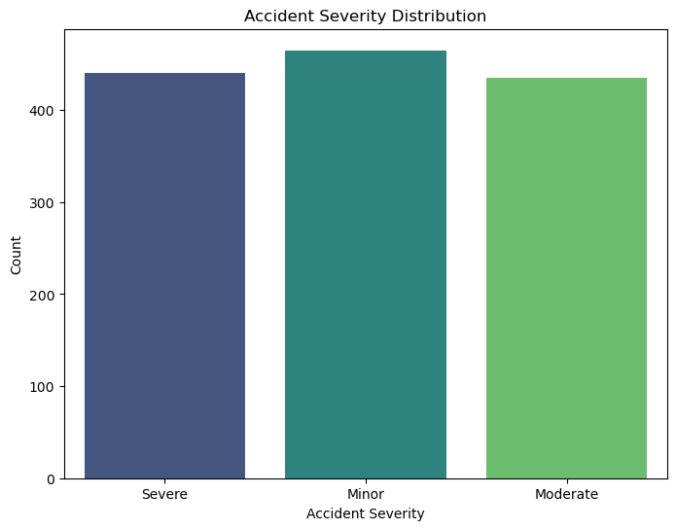
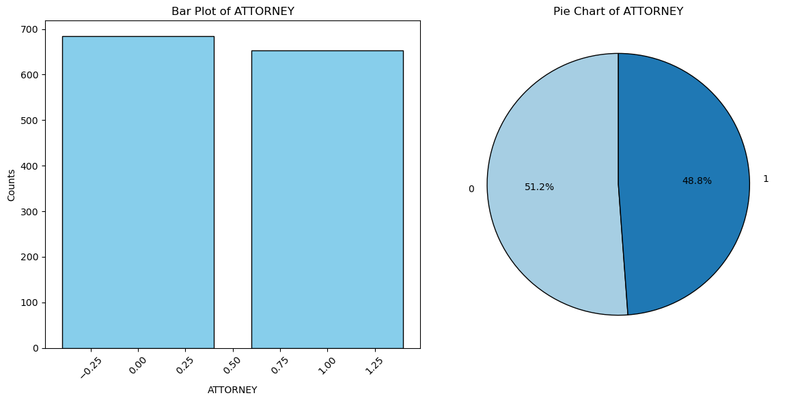
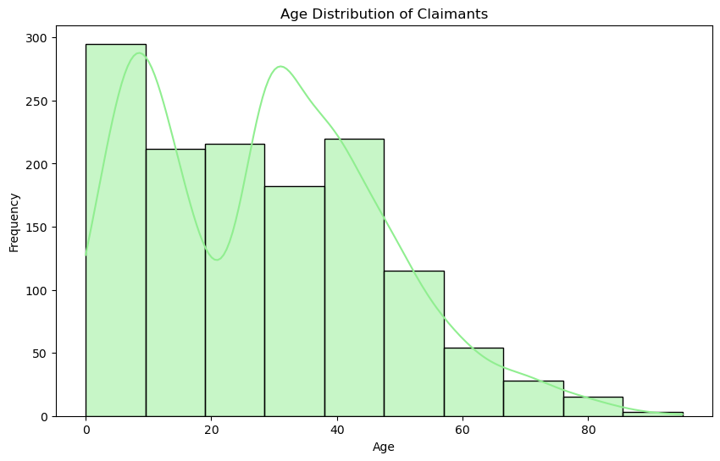
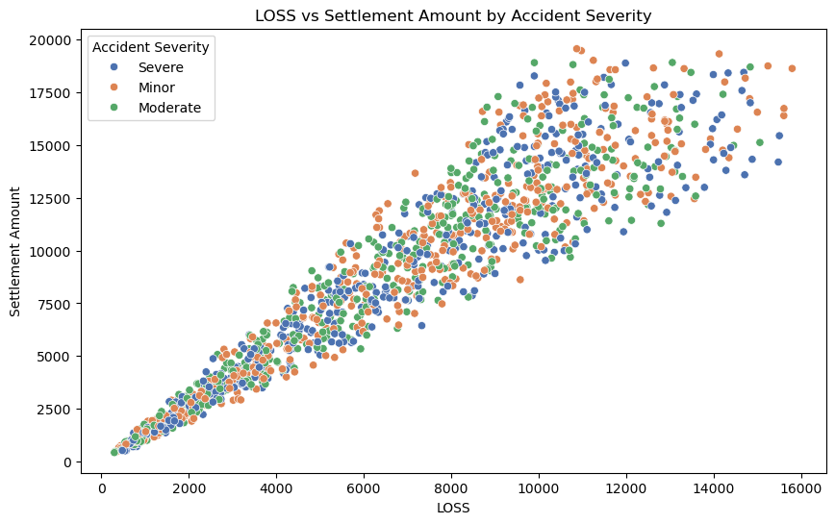
Data Visualization
Attorney counts in cases

Slide 6
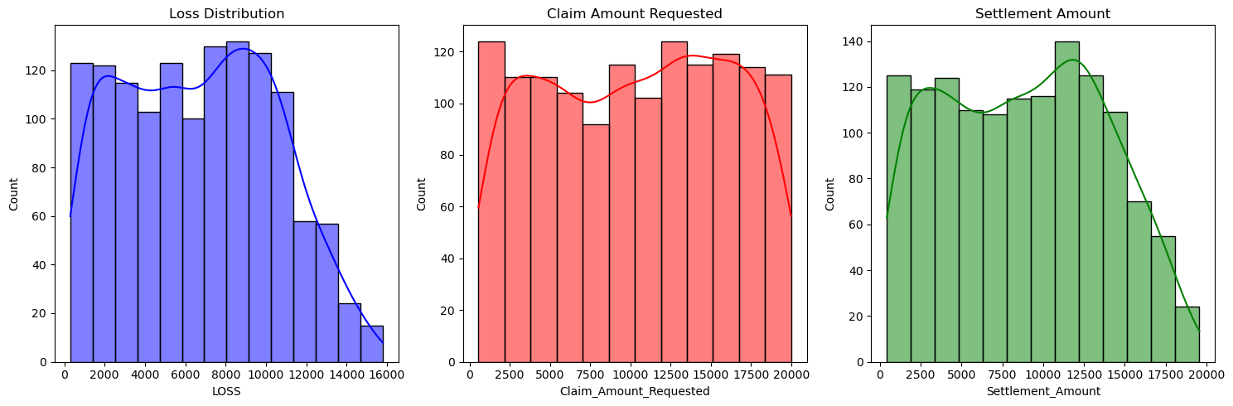
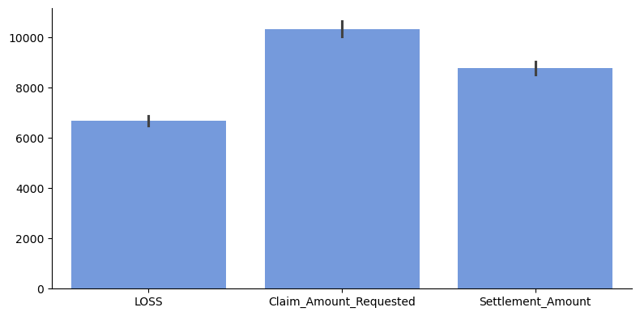
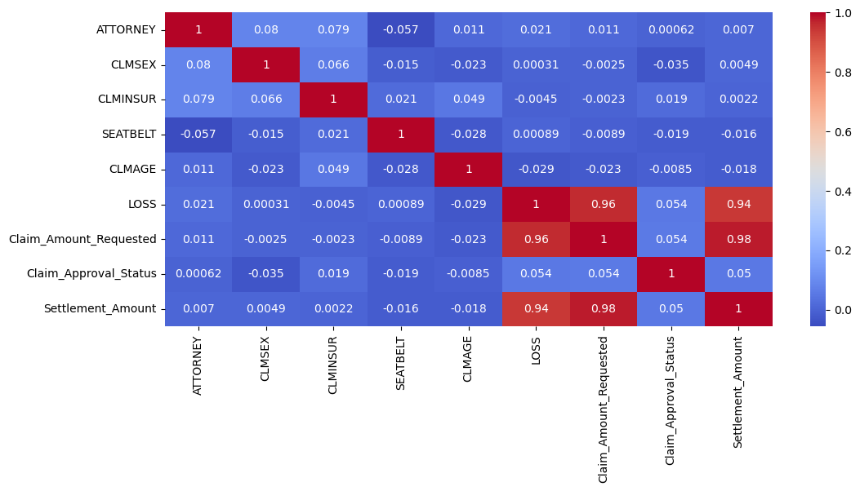
Histogram and KDE plot
Bar plot
Correlation Heat map

Slide 7
Data preprocessing
Missing Values: Analysis of the dataset revealed 189 missing values in the CLMAGE variable, which will be addressed through appropriate imputation techniques to ensure data completeness before developing the predictive model for attorney involvement in claims.
Normalization/Scaling: We standardized both training and test feature sets using the Standard Scaler method prior to model building, ensuring consistent scaling across all variables for optimal predictive performance. This is beneficial for models like those based on distance calculations (e.g., K-Nearest Neighbors, Support Vector Machines) to ensure no single feature dominates due to scale.
Outliers Removal: We removed outlier by Isolation forest method with contamination level of 0.1 and we noticed that data set size is reduced to 1098 X 13.
Deleting useless Features: We removed Case Num, Claim amount Requested ,Claim approval status and Driving Record Columns .Which we found are not effective and Useful.

Slide 8
MODEL BUILDING
Model building in Python refers to the process of creating a predictive or analytical model using statistical or machine learning techniques.
It typically involves several steps:
Data Collection: Load data from sources like CSV files, databases, or APIs.
Data Preprocessing: Handle missing values, encode categorical variables, and normalize data.
Exploratory Data Analysis (EDA): Analyze distributions, relationships, and correlations
Feature Engineering: Create new features, select important ones, and transform data.
Splitting Data: Divide data into training and testing sets (e.g., using train_test_split from sklearn).
Model Selection: Choose a model based on the problem (e.g., Linear Regression for regression, Decision Tree for classification).
Model Training: Fit the model to the training data.
Model Evaluation: Assess model performance using metrics like accuracy, RMSE, R², or F1-score
Hyper parameter Tuning: Optimize model parameters for better performance.
Model Deployment: Deploy the model for real-world use.

Slide 9
Model Selection: Model is selected based on the accuracy’s that we are gained with respective models and all ML Supervised Classification model are trained, tested and finally evaluated based on this evaluation final model is selected.
Model Accuracy’s:
Random Forest: 57%
Logistic Regression: 54%
Support Vector Machine (SVM): 49%
Decision Tree: 56%
KNN: 52%
Naive Bayes: 50%
Gradient Boosting: 53%
Neural Networks : 51%
Selecting a Suitable Model: We all found that Random Forest which is an Ensemble model doing well in both Testing and Training as well as in prediction.

Slide 10
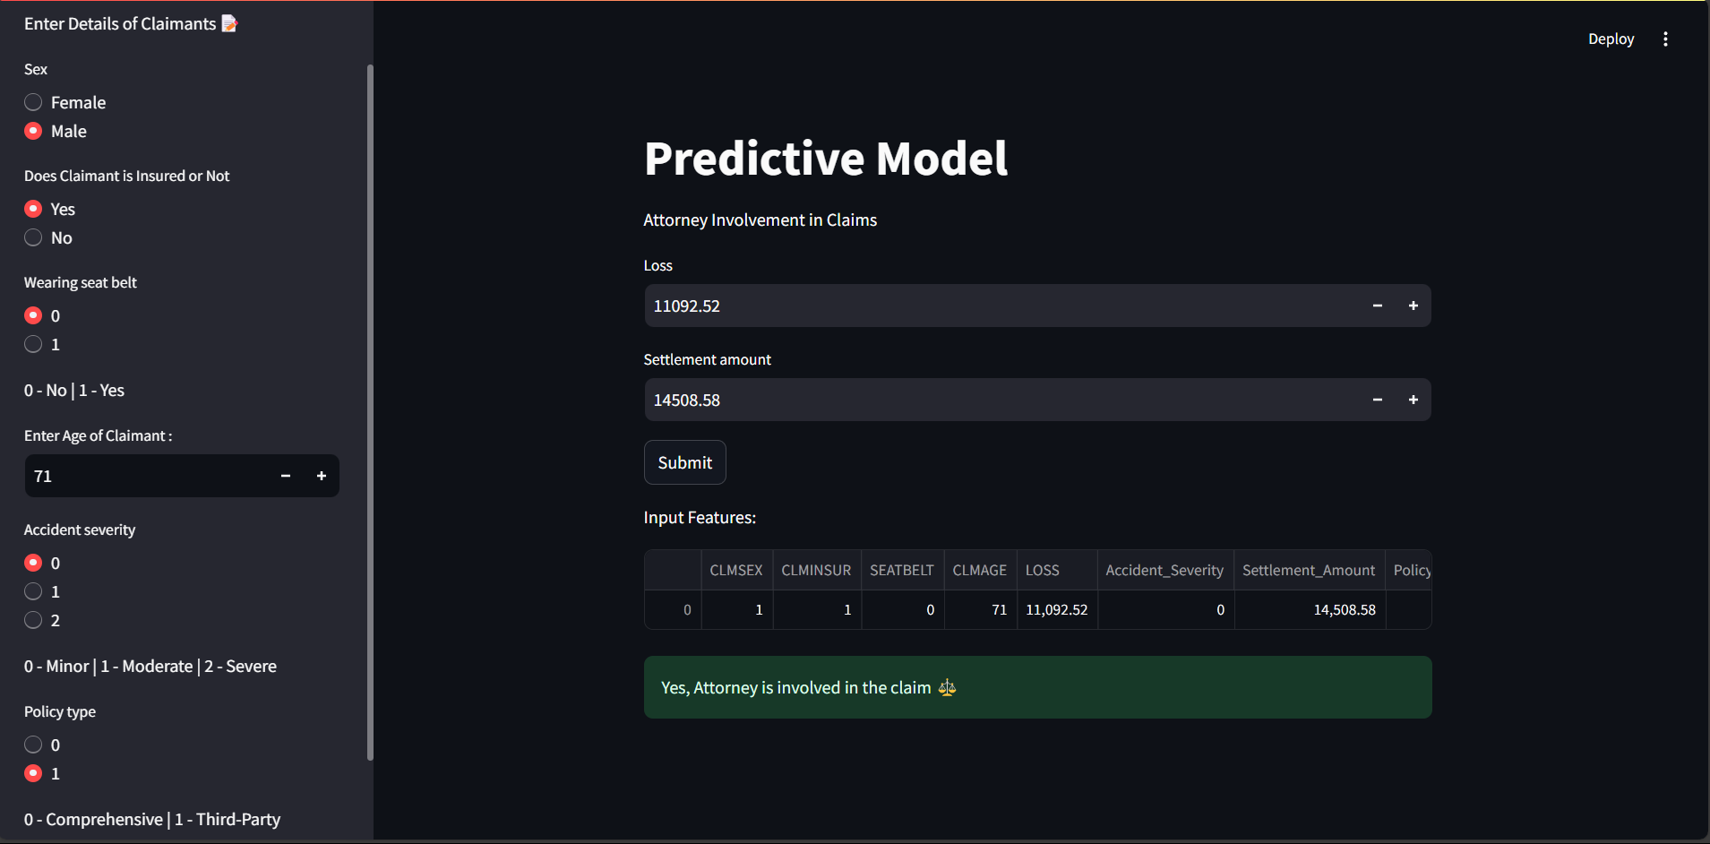
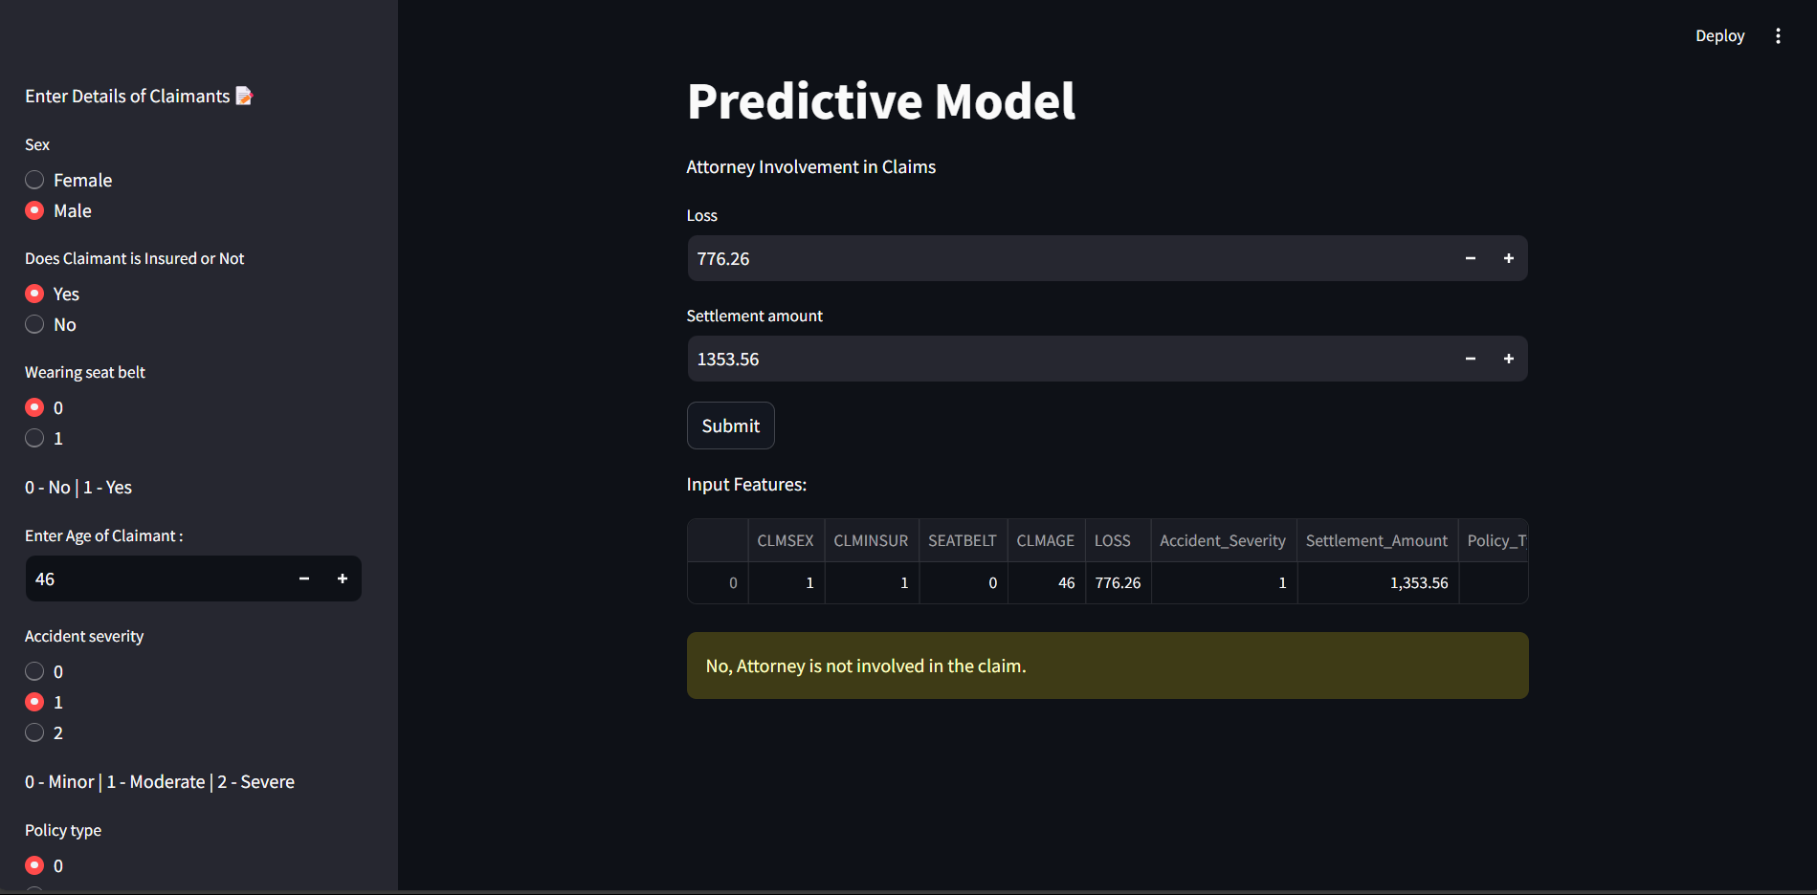
Deployment of Model
Build ML model is converted into Pickle file and then Model is Deployed through stream lit Application for client easiness.
The Input need to be given in and Output displays on screen either Attorney is involved or not.
insure.py is the deployment file and Here are the Reference Interfaces of model which are deployed.
On shows Attorney involved and other show No attorney is involved.

Slide 11
Conclusion:
At Initial stage we thoroughly gone through data set and observed what are what.
Then by Pandas we loaded data set.
Basic Data Set is inspected which includes shape of dataset, info of data set, Description regarding it, Data types and other.
EDA is performed in that Data is Visualized for gaining some insights regarding data and its behavior.
After performing all preprocessing process( Scaling, Outliers removal, Imputing data and Encoding it ).
We went to model selecting, In that we Trained, Tested and evaluated all Model metrics based on the model Accuracy we opted for Random Forest Model,
With that model we Deployed it with the help of Stream lit application.
Finally, Model is doing well in both positive and negative cases.

Slide 12
Thank you

